Slide 1
Presentation
On Formal Vs Informal Communication

Slide 2

Intro
Communication is how we share ideas, thoughts, and information People communicate in different ways depending on the situation There are two main types of communication:
Formal communication Informal communication

Slide 3

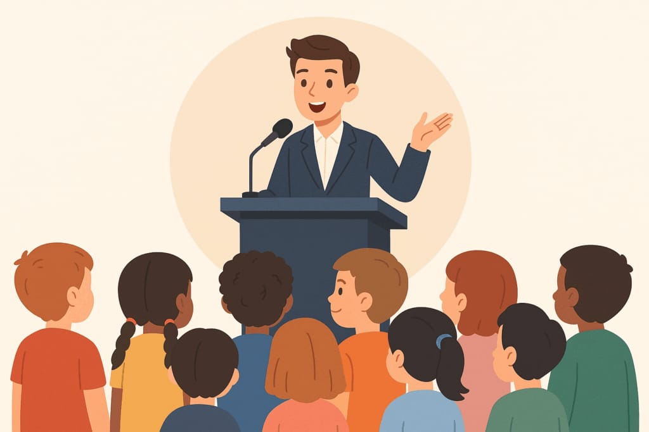
What Is Communication?
Communication means sharing ideas or information
We communicate by:
Talking Writing

Slide 4


Formal Communition
Formal communication is: Polite and respectful Uses proper grammar
Carefully written or spoken
Used when:
Talking to teachers Writing school emails Giving presentations
e.g: “Good morning, may I ask a question?”

Slide 5



Informal Communication
Informal communication is: Casual and friendly Uses simple words Relaxed tone
Used when:
Talking to friends Texting family
Example:
“Hey, can I ask you something?”

Slide 6


Formal
Polite
Full sentences No slang School/work
Differences
Informal
Casual
Short sentences Uses slang Friends/family

Slide 7

When to Use Each One
formal communication
Use formal communication in school
or serious situations
informal communication
Use informal communication with people you know well

Slide 8

Thanku

